Slide 1

Olympic Data Analysis
Niharika Sahu
Harish Sargar
Laxman Sawant
51
52
53

Slide 2
Abstract
The Olympic Games, an iconic symbol of global unity and athletic excellence, bring together athletes from 205 nations every four years. Our research focuses on unraveling the layers of Olympic data, using data science to transform it into valuable insights.
We have developed predictive algorithms considering factors like an athlete's physical attributes and past performance to estimate winning probabilities in specific events. This predictive element benefits athletes, coaches, and countries in optimizing their medal-winning strategies.
Additionally, our research employs data visualization techniques to create an interactive world map, offering a comprehensive geographical perspective on countries' historical medal counts. This map deepens our understanding of the Olympics' global impact.
In summary, our research provides a holistic journey through Olympic history, merging historical analysis, predictive modeling, and global visualization.
It offers valuable insights for athletes, coaches, and policymakers as they navigate the evolving world of the Olympics and aim for future success in this renowned sporting event.

Slide 3
Introduction
Olympic games are considered as one of the most prime events which provides a valid and common platform for players across different countries to show their talent and skills.
The Olympics consists of various games (Approximately 45) in which players from various countries (Approx 205) participate to win a medal for their country.
This Event is held every 4 years, Analyzing its data can provide valuable insights into athlete performance, medal counts, historical trends, and other factors that influence the outcome of the games.
Our main goal here is to use Python to dive into the Olympic dataset and transform raw data into graphs and data-frames using Exploratory Data Analysis.
We have also visualized data on a world map to provide a geographical perspective on countries' performance in the Olympics. This could lead to more comprehensive insights.
Further we have used machine learning algorithms to predict the athletes’ winning probability in a particular game

Slide 4
Problem Statement
Analyzing the Olympic Games' vast dataset, which spans over a century, poses a significant challenge for individuals and organizations.
This challenge arises from the sheer volume of data, including athlete details, event results, and historical records, encompassing hundreds of thousands of athletes, thousands of events across multiple Olympic Games, and gigabytes of data in diverse formats.
The complexity of the data further compounds the challenge, as it involves multiple Olympic Games with distinct rules and formats, evolving event categories, and the influence of shifting geopolitical landscapes on athlete participation.
Consequently, researchers and analysts confront information overload when attempting to extract meaningful insights from this wealth of data. Manual analysis, the typical approach, proves time-consuming and often inefficient, hindering the ability to draw timely conclusions.
Addressing these challenges is vital to unlock the Olympic dataset's full potential, enabling a deeper understanding of both the historical and evolving aspects of this iconic global sporting event.

Slide 5
Proposed System
To address this challenge, we have data analytics techniques and technologies to efficiently process and analyze the Olympic dataset.
Our goal is to extract valuable insights, uncover hidden patterns, and present the information in a way that is understandable and accessible to a wide audience.
We want to develop a platform that will be visualizing data through graphs, structuring data into informative data frames, and applying statistical techniques to discover meaningful patterns within the data.
Further we would develop a prediction model that is accurate which can effectively forecast future Olympic games medalists.
We are also interested in developing a geospatial data visualization platform, where data is represented on a map allowing users to interactively explore and analyze stats related to each participating nation.

Slide 6
Literature survey
Name of the Research Paper | Olympic Data Analysis using Data Science
Author Name | Nishant Kulkarni, Pratik Patil, Rugved Pande, Dhiraj Patil, Pranav Nair, Parth Prabhu, Pratyush Doshi, Pranav Bhosale
Year | 2022
Techniques Used | The primary technique used in this paper is EDA which is an approach of analyzing large datasets by summarizing data in graphical formats such as histograms, bar, box, & scatter plots. In this paper, EDA is used to visualize and analyze various factors related to the Olympics, including the performance of countries, the contribution of men and women, and trends over time
Drawbacks | One potential drawback of this paper is that it does not mention the use of any specific machine learning algorithms for predictive analysis. While EDA is a powerful technique for data exploration and visualization, it is primarily descriptive in nature To enhance the paper's analytical capabilities, the authors could have explored the application of machine learning algorithms to predict future trends or outcomes in Olympic events.
Future Scope | Geographical Visualization. The authors suggest that data could be visualized on a world map to provide a geographical perspective on countries performance in the Olympics. This could lead to more comprehensive insights. Machine Learning Predictions: As mentioned earlier, the paper could benefit from the application of machine learning algorithms for predictive analysis. Predictive models could be developed to forecast Olympic performance or identify factors contributing to success.

Slide 7
Literature survey
Name of the Research Paper | Analyzing Evolution of the Olympics by Exploratory Data Analysis Using R
Author Name | Rahul Pradhan , Kartik Agrawal and Anubhav Nag
Year | 2021
Techniques Used | The research paper employs Exploratory Data Analysis (EDA) as the primary technique to analyze the large dataset related to the Olympics. In this case, EDA is used to explore various factors contributing to the evolution of the Olympic Games over the years
Drawbacks | Some potential limitations could include the reliance on historical data, the choice of analytical techniques, and the assumptions made during the analysis. Additionally, the paper primarily focuses on data visualization and analysis but may not delve into more advanced statistical or machine-learning methods for predictive modeling.
Future Scope | Further Predictive Modelling: The authors can expand their analysis by developing predictive models to forecast future trends in Olympic Games based on historical data.. Machine Learning Applications: Incorporating machine learning algorithms for more in-depth analysis, to gain a more comprehensive understanding of the factors affecting Olympic performance. Geospatial Analysis: Utilizing geographical data to analyze the geographic distribution of Olympic events and their impact on host cities and regions. Incorporating more recent data: As the paper was published in 2021, including data from subsequent Olympic Games to provide a more up-to-date analysis.

Slide 8
Literature survey
Name of the Research Paper | Web Application of the Olympic data analysis.
Author Name | Farkande Vaishnavi, Gurav Vaishnavi, Borse Tejas
Year | 2012
Techniques Used | The paper primarily employs Exploratory Data Analysis (EDA) to analyze Olympic data from 1896 to 2016. EDA involves examining large datasets and exploring various characteristics through visual formats like graphs and charts. The use of visual methods to provide a deep understanding and statistical summary of the data is highlighted.
Drawbacks | The paper briefly mentions potential drawbacks but does not go into detail. These drawbacks include the possible variation in analysis due to historical or geographical changes. There is a focus on visualizing data in graphical formats, but potential limitations of this approach, such as data quality issues or biases in the data, are not thoroughly discussed.
Future Scope | Visualizing data in geographical formats, such as mapping countries' Olympic performance on a world map. Exploring the application of machine learning algorithms to the dataset to create predictive models for future Olympic Games. Conducting correlation analysis to analyze relationships between different variables in the dataset. These future scopes aim to enhance the analysis of the Olympics' evolution and provide more insights into the dataset.

Slide 9
Literature survey
Name of the Research Paper | Data Analytics on Olympics Datasets
Author Name | Surya Sena Reddy, Suraj Kumar.
Year | 2022
Techniques Used | The research paper employs data analytics techniques, particularly Descriptive Analytics and Predictive Analytics, to analyze data from the Olympics datasets. They utilize Python and various libraries, including NumPy, Pandas, Scikit-learn (Sklearn), Plotly, Streamlit, and Matplotlib for data analysis and visualization
Drawbacks | The research paper doesn't explicitly mention any drawbacks. However, based on the content provided, a potential limitation could be the assumption that linear regression is the best model for predicting athlete weight based on height, as the accuracy is around 63 percent. More sophisticated machine learning models might be explored for better predictions.
Future Scope | The paper suggests areas for future research, including improving the accuracy of predictive models. For example, enhancing the weight prediction model based on height and exploring more advanced machine learning algorithms could be a potential future scope. Furthermore, expanding the analysis to include data beyond 2016 could provide insights into more recent Olympic events and trends.

Slide 10
Literature survey
Name of the Research Paper | Web Application of Olympic Data Analysis.
Author Name | Shivam Bansal, Vaibhav Yadav, Sahil, Yashshavi Prajapti, Rashmi Tiwari.
Year | 2023
Techniques Used | Data Collection and Preprocessing: Collected Olympic data from public sources and prepared it for analysis by cleaning and focusing on Summer Olympics data. Exploratory Data Analysis (EDA): Analyzed the data using Python libraries to gain insights into Olympic history, country performance, and athlete factors.
Drawbacks | Data Collection and Preprocessing: Collected Olympic data from public sources and prepared it for analysis by cleaning and focusing on Summer Olympics data. Exploratory Data Analysis (EDA): Analyzed the data using Python libraries to gain insights into Olympic history, country performance, and athlete factors.
Future Scope | Implement predictive modeling using machine learning for Olympic predictions. Extend the application to cover major sporting events like the Commonwealth Games and Asian Games. Include real-time updates and live scores for ongoing Olympic events. Ongoing research for deeper insights into sports and countries' performance.

Slide 11
Details of Hardware & Software required
Hardware:
Processor: Intel i3
RAM: 2 GB
Hard disk: 256 GB Storage Drive.
Software:
Operating System: Windows 10.
Programming Language: Python 3.6.
Machine Learning A: Logistic Regression.
IDE: Jupyter Notebook, PyCharm, Visual Studio Code.
Library: Streamlit, Geopandas, Matplotlib, Plotly

Slide 12
Flow of System
Raw Data
Collection of raw data
Data processing
Clean dataset
Exploratory Data Analysis
Machine Learning
Data visualization
Map visualization
Bar graph
histogram
Scatter plots
Predicting Medal winner

Slide 13
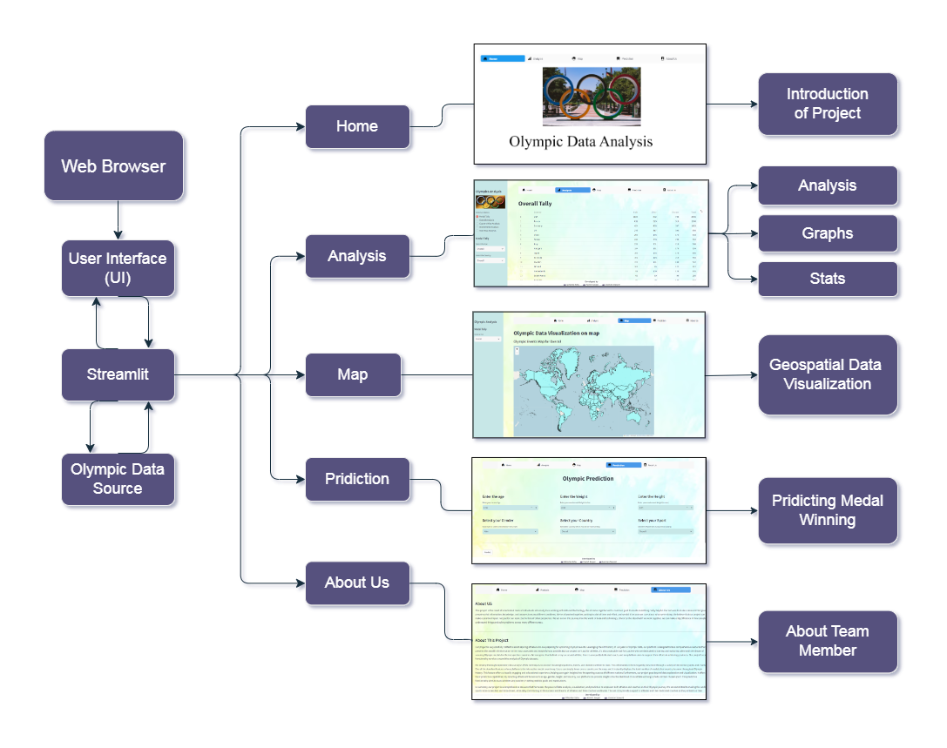
Architecture

Slide 14
Methodology
1] Analysis:
Define the Purpose and Scope: We clearly stated the objectives of the data analysis report and defined its scope.
Data Collection and Preparation: We gathered and cleaned the data needed for analysis. We also handled missing values, outliers, and inconsistencies to ensure data integrity.
Data Exploration: We performed exploratory data analysis (EDA) to understand the dataset's characteristics. We also generated summary statistics, distributions, and basic visualizations.
Hypotheses and Questions: We have listed the hypotheses or questions we aim to answer through the analysis. This provides a clear focus for the report.
Data Visualizations: We also presented a variety of visualizations, including charts, graphs, and plots, to illustrate key insights and trends. We used appropriate visualization tools like Matplotlib, Seaborn.
Findings and Insights: Presented the results of the analysis, including any patterns, relationships, or anomalies discovered. We interpreted the data and provided insights.
Conclusion and Recommendations: We summarized the main findings and also provided conclusions based on the analysis. We also offered recommendations or actionable insights if relevant.

Slide 15
Methodology
2] Data Visualization on a World Map
Data Merging: The processed Olympic data is merged with geospatial information of world countries. This step establishes the link between a country's medal tally and its geographical location.
Map Center: The map's center location is determined, either as a specific country of interest or a default location for initial display.
Color Scale Configuration: The color scale is configured to shade the countries on the map based on their total medal counts (Medal they have won each year). Calculations are performed to determine the minimum and maximum total medals won by each country, creating a gradient.
GeoJSON Layers: GeoJSON layers are created for each country. Customization includes specifying factors like fill color, border color, line weight, and opacity based on medal tallies. These visual cues help users interpret data visually.
Final Output: The completed Streamlit app provides an engaging and informative platform for Olympic data analysis and visualization. Users can explore and interact with the data, by hovering on the map, gaining valuable insights into medal distribution across different countries and years.

Slide 16
Methodology
3] Prediction
This methodology outlines the steps for building a Logistic Regression model to predict the winning probability of Olympic medals for athletes based on their height, weight, country, and sport. The aim is to develop a model that can provide insights into the likelihood of an athlete winning a medal in the Olympic Games.
Data Preparation: Collected and cleaned datasets including athlete info, country, sport, and medal data. Merged relevant data based on common keys.
Feature Selection: Choose key features like height, weight, country, and sport. Model Development. Use Logistic Regression for binary classification (win/lose).
Model Training: Trained the model using the training dataset.
Predict Winning Probability: Used the trained model to predict the winning probability of medals for new athletes or for athletes in historical data.
Model Evaluation: Assessed model performance with metrics like accuracy and F1-score.

Slide 17
conclusion
In summary, our project is a comprehensive resource that harnesses the power of data analysis, visualization, and prediction to empower both athletes and coaches on their Olympic journey.
The aim is to provide support to athletes and their dedicated coaches as they embark on their Olympic journeys, ensuring they are equipped with the information and guidance needed to reach new heights of success.
One of the standout features of our platform is the interactive medal count map. Users can simply hover over a country on the map, and it instantly displays the total number of medals that country has won throughout Olympic history.
Furthermore, our project goes beyond data exploration and visualization. It offers basic predictive capabilities. By inputting athlete attributes such as age, gender, height, and country, our platform can provide insights into the likelihood of an athlete winning a medal in their chosen sport. This predictive functionality aims to assist athletes and coaches in setting realistic goals and expectations.

Slide 18
Future Scope
The future scope of our project includes enhancing the accuracy and relevance of our Olympic predictions by incorporating data from the upcoming 2024 Olympics.
We plan to create a new dataset with the same comprehensive features as our current dataset, leveraging web scraping techniques to extract real-time data from the official Olympics website.
This endeavor will ensure that our platform remains up-to-date with the latest information, enabling more precise and timely predictions for our users.
Additionally, we are committed to expanding our project's user base by continually improving the user interface and introducing new features to make exploring Olympic data even more engaging and insightful.
This web scraping integration will significantly enhance the system's accuracy and relevance while relieving the need for manual data updates, making it a more efficient and up-to-date tool for Olympic data analysis.

Slide 19
references
Shivam Bansal, Vaibhav Yadav, Sahil, Yashshavi Prajapti, Rashmi Tiwari, “SPORTS SNOOZE: WEB APPLICATION OF OLYMPICS DATA ANALYSIS.”, Volume:5/Issue:02/February-2023.
Surya Sena Reddy, Suraj Kumar, “Data Analytics on Olympics Datasets.”, International Journal of Research Publication and Reviews, Vol 3, no 9, pp 1405-1410, September 2022.
Nishant Kulkarni, Pratik Patil, Rugved Pande, Dhiraj Patil, Pranav Nair, Parth Prabhu, Pratyush Doshi, Pranav Bhosale, “Olympic Data Analysis using Data Science.”, International Journal for Research in Applied Science & Engineering Technology (IJRASET), Volume 10 Issue XII Dec 2022.
Rahul Pradhan, Kartik Agrawal, and Anubhav Nag, “Analyzing Evolution of the Olympics by Exploratory Data Analysis Using R.”, 2021.
Farkande Vaishnavi, Gurav Vaishnavi, Borse Tejas, “Web Application of the Olympic data analysis.”, Vol-8 Issue-3 2022.

